Slide 1




Clinical Trials
The Way We Make Progress Against Disease
Dr. Gaurav Doshi
International Clinical Pharmacist Recognized
Notes:
Whether you have <insert condition>, are a friend or family member of someone with <insert condition>, or someone who works with people with people who have <insert condition>, this presentation will help answer some of the most important questions you may have about clinical trials.
The presentation will include a discussion about:
Why clinical trials are important
How clinical trials work
How clinical trials advance patient care
How participants are protected
Some of the barriers to participating in clinical trials
And finally, I’ll talk about ways you can find clinical trials in your community.

Slide 2
Ethics in Research involving Human Subjects
Notes:
www.imceg.com

Slide 3
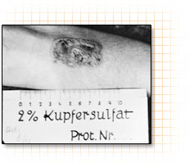
Nazi Medical War Crimes (1939–1945)
Medical Research involving human beings have created a lot of potential pitfalls that led to tragedies in the last century.
Notes:
A well-known chapter in the history of research with human subjects opened on December 9, 1946, when an American military tribunal opened criminal proceedings against 23 leading German physicians and administrators for their willing participation in war crimes and crimes against humanity. Among the charges were that German physicians conducted medical experiments on thousands of concentration camp prisoners without their consent. Most of the subjects of these experiments died or were permanently crippled as a result.
Prior to 1906, when the Pure Food and Drug Act was passed, there were no regulations regarding the ethical use of human subjects in research. There were no consumer regulations, no Food and Drug Administration (FDA), no Common Rule, and no Institutional Review Board (IRB). What follows is a brief discussion of why federal rules and regulations were established and why the IRB became a necessity.
The Nazi War crimes have been one of the first large scale known violations against human subjects
A photo for a burn induced in one of the prisoners , in a study for traetment of burns

Slide 4
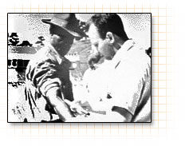
Tuskegee Syphilis Study - Alabama
The study was stopped in 1973 by the U.S. Department of Health, Education, and Welfare only after its existence was publicized and it became a political embarrassment. In 1997, under mounting pressure, President Clinton apologized to the study subjects and their families.
Notes:
http://www.tuskegee.edu/Global/Story.asp?s=1207598
Tuskegee Syphilis Study (1932-1972). An equally well known chapter in history occurred during a research project conducted by the U.S. Public Health Service. Six hundred low-income African-American males, 400 of whom were infected with syphilis, were monitored for 40 years. Free medical examinations were given; however, subjects were not told about their disease. Even though a proven cure (penicillin) became available in the 1950s, the study continued until 1972 with participants being denied treatment. In some cases, when subjects were diagnosed as having syphilis by other physicians, researchers intervened to prevent treatment. Many subjects died of syphilis during the study.

Slide 5
Tuskegee Syphilis Study
http://www.tuskegee.edu/Global/Story.asp?s=1207598
Tuskegee Syphilis Study (1932-1972).
An equally well known chapter in history occurred during a research project conducted by the U.S. Public Health Service.
Six hundred low-income African-American males, 400 of whom were infected with syphilis, were monitored for 40 years.
Free medical examinations were given; however, subjects were not told about their disease. Even though a proven cure (penicillin) became available in the 1950s, the study continued until 1972 with participants being denied treatment.
In some cases, when subjects were diagnosed as having syphilis by other physicians, researchers intervened to prevent treatment. Many subjects died of syphilis during the study.
Notes:
http://www.tuskegee.edu/Global/Story.asp?s=1207598
Tuskegee Syphilis Study (1932-1972). An equally well known chapter in history occurred during http://www.tuskegee.edu/Global/Story.asp?s=1207598
Tuskegee Syphilis Study (1932-1972). An equally well known chapter in history occurred during a research project conducted by the U.S. Public Health Service. Six hundred low-income African-American males, 400 of whom were infected with syphilis, were monitored for 40 years. Free medical examinations were given; however, subjects were not told about their disease. Even though a proven cure (penicillin) became available in the 1950s, the study continued until 1972 with participants being denied treatment. In some casesa research project conducted by the U.S. Public Health Service. Six hundred low-income African-American males, 400 of whom were infected with syphilis, were monitored for 40 years. Free medical examinations were given; however, subjects were not told about their disease. Even though a proven cure (penicillin) became available in the 1950s, the study continued until 1972 with participants being denied treatment. In some cases, when subjects were diagnosed as having syphilis by other physicians, researchers intervened to prevent treatment. Many subjects died of syphilis during the study.

Slide 6
Other Major Violations to Human Research Subjects
1963 -- Brooklyn - Jewish Chronic Diseases Hospital: Cancer cells were injected into debilitated elderly patients to see if they would immunologically reject the cells.
1972 - Willowbrook State Hospital in New York: Retarded children were deliberately infected with viral hepatitis to study its natural history.

Slide 7
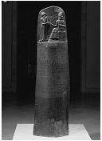
It is clear that Various cultures such as ancient Egypt , Persia , Babylonia and Greece have attempted to regulate medicine and protect patient rights.
One of the earliest written provisions in the field is that comes about 1750 BC is the Code of Hammurabi.
.
Notes:
Polished Black Diorite Steel 1792 – 1750 BC WITH CODE OF Hammurabi inscribed and bas-relief at top of showing king receiving laws from Sun God

Slide 8
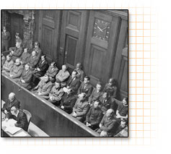
The Nuremberg Code
  Voluntary informed consent
  Likelihood of some good resulting
  Based on prior research (animal models)
  Avoidance of physical or psychological injury or harm
  Benefits should outweigh risks
  Proper experience of researcher
  Right to withdraw consent
  Research must stop if harm is resulting
  (no specific mention of children, unconscious people, or others who may not be competent to give consent)
Notes:
As a direct result of the trial, the Nuremberg Code was established in 1948, stating that "The voluntary consent of the human subject is absolutely essential," making it clear that subjects should give consent and that the benefits of research must outweigh the risks.
Although it did not carry the force of law, the Nuremberg Code was the first international document which advocated voluntary participation and informed consent.

Slide 9
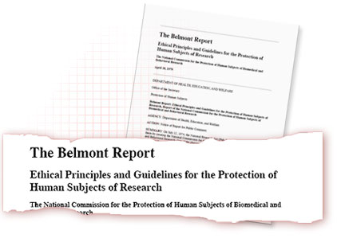
National Commission for the Protection of Human Subjects of Biomedical and Behavioral Research in 1974.
Respect for persons
Beneficence
Justice
Notes:
The National Research Act codified the requirement that human subjects in research must be protected and set the stage for the issuance of the Belmont Report.
THE BELMONT REPORT
Carrying out its charge, the National Commission for the Protection of Human Subjects of Biomedical and Behavioral Research prepared the Belmont Report in 1979. The Belmont Report attempts to summarize the basic ethical principles identified by the Commission in the course of its deliberations. The Report is a statement of basic ethical principles and guidelines that should assist in resolving the ethical problems that surround the conduct of research with human subjects.

Slide 10
THE BELMONT REPORT
The National Research Act codified the requirement that human subjects in research must be protected and set the stage for the issuance of the Belmont Report.
THE BELMONT REPORT
Carrying out its charge, the National Commission for the Protection of Human Subjects of Biomedical and Behavioral Research prepared the Belmont Report in 1979. The Belmont Report attempts to summarize the basic ethical principles identified by the Commission in the course of its deliberations. The Report is a statement of basic ethical principles and guidelines that should assist in resolving the ethical problems that surround the conduct of research with human subjects.
Notes:
The National Research Act codified the requirement that human subjects in research must be protected and set the stage for the issuance of the Belmont Report.
THE BELMONT REPORT
Carrying out its charge, the National Commission for the Protection of Human Subjects of Biomedical and Behavioral Research prepared the Belmont Report in 1979. The Belmont Report attempts to summarize the basic ethical principles identified by the Commission in the course of its deliberations. The Report is a statement of basic ethical principles and guidelines that should assist in resolving the ethical problems that surround the conduct of research with human subjects.

Slide 11
Helsinki Declaration
The World Medical Association (WMA) has developed the Declaration of Helsinki as a statement of ethical principles for medical research involving human subjects, including research on identifiable human material and data. The first version was adopted in 1964 and has been amended six times since, most recently at the General Assembly in October 2008. The current (2008) version is the only official one.
Notes:
Declaration of Helsinki. In 1964, the World Medical Association established recommendations guiding medical doctors in biomedical research involving human subjects. The Declaration governs international research ethics and defines rules for "research combined with clinical care" and "non-therapeutic research." The Declaration of Helsinki was revised in 1975, 1983, 1989 and 1996 and is the basis for Good Clinical Practices used today.
Issues addressed in the Declaration of Helsinki include:
Research with humans should be based on the results from laboratory and animal experimentation
Research protocols should be reviewed by an independent committee prior to initiation
Informed consent from research participants is necessary
Research should be conducted by medically/scientifically qualified individuals
Risks should not exceed benefits

Slide 12
Helsinki Declaration
In 1964, the World Medical Association established recommendations guiding medical doctors in biomedical research involving human subjects.
The Declaration governs international research ethics and defines rules for "research combined with clinical care" and "non-therapeutic research.“
The Declaration of Helsinki was revised in 1975, 1983, 1989 and 1996 and is the basis for Good Clinical Practices used today.
Notes:
Declaration of Helsinki. In 1964, the World Medical Association established recommendations guiding medical doctors in biomedical research involving human subjects. The Declaration governs international research ethics and defines rules for "research combined with clinical care" and "non-therapeutic research." The Declaration of Helsinki was revised in 1975, 1983, 1989 and 1996 and is the basis for Good Clinical Practices used today.
Issues addressed in the Declaration of Helsinki include:
Research with humans should be based on the results from laboratory and animal experimentation
Research protocols should be reviewed by an independent committee prior to initiation
Informed consent from research participants is necessary
Research should be conducted by medically/scientifically qualified individuals
Risks should not exceed benefits

Slide 13
Helsinki Declaration
Issues addressed in the Declaration of Helsinki include:
Research with humans should be based on the results from laboratory and animal experimentation
Research protocols should be reviewed by an independent committee prior to initiation
Informed consent from research participants is necessary
Research should be conducted by medically/scientifically qualified individuals
Risks should not exceed benefits
Notes:
Declaration of Helsinki. In 1964, the World Medical Association established recommendations guiding medical doctors in biomedical research involving human subjects. The Declaration governs international research ethics and defines rules for "research combined with clinical care" and "non-therapeutic research." The Declaration of Helsinki was revised in 1975, 1983, 1989 and 1996 and is the basis for Good Clinical Practices used today.
Issues addressed in the Declaration of Helsinki include:
Research with humans should be based on the results from laboratory and animal experimentation
Research protocols should be reviewed by an independent committee prior to initiation
Informed consent from research participants is necessary
Research should be conducted by medically/scientifically qualified individuals
Risks should not exceed benefits

Slide 14


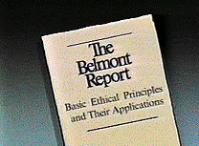

Slide 15
Introduction and History
Location
Study Clinician
Study details
Study Termination and Aftermath
National Research Act
National Commission for the Protection of Human Subjects of Biomedical and Behavioral Research.
Belmont Report
Ethical Principles & Guidelines for Research Involving Human Subjects
Application of General Principle
Importance of Belmont Report in Clinical Research
Belmont Report in prospect with Indian (ICMR) Guidelines.

Slide 16



Slide 17

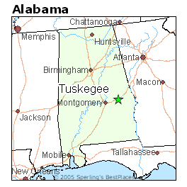
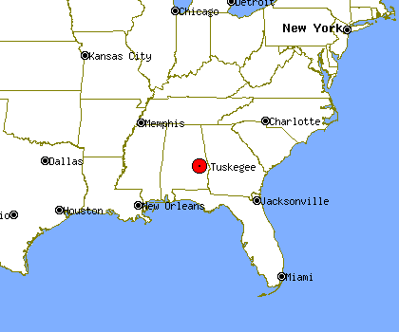
Location
Tuskegee study was conducted in province of America in Alabama.
It is situated in South Eastern region of the country.

Slide 18
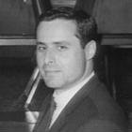
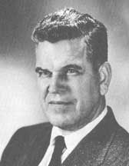
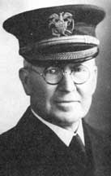
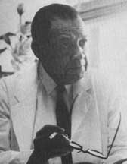
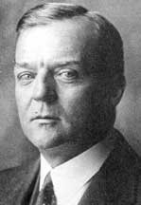
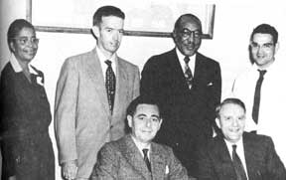
Study Clinicians
Dr. Taliaferro Clark, formed the study group.
Dr. Eugene Dibble, Head of John Andrew Hospital.
Dr. Oliver C. Wenger.
Dr. Raymond H. Vonderlehr, on-site Director.
Nurse Eunice Rivers

Slide 19
STUDY DETAILS
Initially the subjects were studied for 6-8 months, then treated with contemporary methods including Salvarsan, mercurial ointments, and bismuth.
The Tuskegee University-affiliated hospital effectively loaned the PHS its medical facilities.
Patients received free physical examinations at Tuskegee University, free rides to and from the clinic, hot meals on examination days, and free treatment for minor ailments.
Out of the 600 low income African-American males, 399 with latent syphilis and 201 males without disease as controls were enrolled in the study.

Slide 20
Continuing effects of the Stock Market Crash of 1929 and the beginning of the Great Depression led the Rosenwald Fund to withdraw its offer of funding.
No funding implied end of the study, therefore study directors issued a final report.
The Tuskegee study group decided to salvage their work and perform a prospective study equivalent to the Oslo Study.
Consent of the subjects for non therapeutic diagnostic ‘spinal taps’ by depicting the diagnostic test as a “special free treatment.”

Slide 21
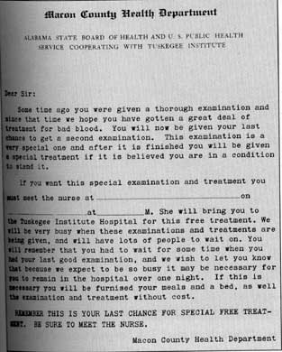
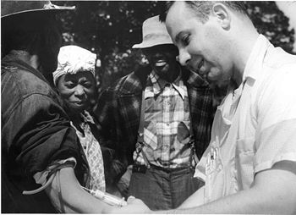

Slide 22
Many patients were lied to and given placebo treatments so that researchers could observe the progression of the fatal disease.
In 1934, the Tuskegee Study published its first clinical data, and issued their first major report in 1936,prior to the discovery of penicillin as treatment for syphilis.
By 1947 penicillin had become standard therapy for syphilis.
The subjects were prevented from participating in Syphilis eradicative campaigns, thus depriving chance for cure.

Slide 23
Study Termination and Aftermath
In 1972 the Tuskegee Study was brought to public and national attention by Peter Buxtun (whistleblower), who gave information to the “Washington Star” and the “New York Times”.
Peter Buxtun wrote letter to the director of Venereal Disease Division showing concern for the ethics and morality of the Tuskegee Study.
The Centre for Disease Control(CDC) along with NMA, AMA reaffirmed the need to continue the study.
In 1968 William (Bill) Carter Jenkins, founded and edited ‘The Drum’, a newsletter, where he called for the end of the study. But did not succeed.

Slide 24
Finally Peter Buxtun broke the story first in the Washington Star on July 25,1972 and the following day in the New York Times.
A congressional hearing was held by Senator Edward Kennedy.
The CDC and PHS appointed an advisory committee who reviewed the study as medically unjustified and ordered its termination.
After end of study,28 men had died of syphilis,100 were dead of related complications,40 of their wives had been infected, and 19 of their children had been born with congenital syphilis.
A class action lawsuit was filed where the U.S. government paid $9 million.

Slide 25
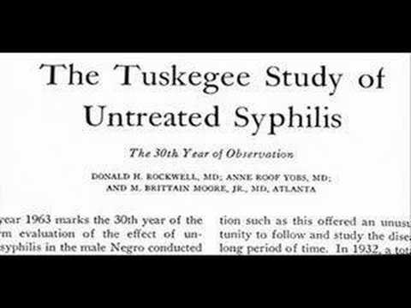
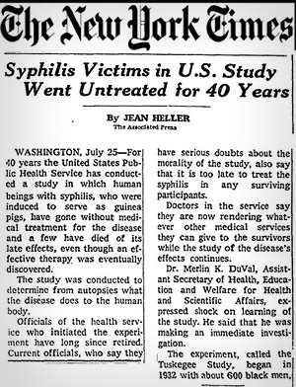

Slide 26
"The United States government did something that was wrong—deeply, profoundly, morally wrong. It was an outrage to our commitment to integrity and equality for all our citizens... clearly racist."
—President Clinton's apology for the Tuskegee Syphilis Experiment to the eight remaining survivors, May 16, 1997.
The Tuskegee Syphilis Study significantly damaged the trust of the black community toward public health efforts in the United States.

Slide 27

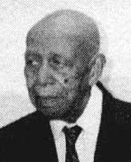
The Tuskegee Syphilis Study was in violation of all three requirements proposed by the Judiciary:
The voluntary consent of the person on whom the experiment is to be performed must be obtained.
The danger of each experiment must be previously investigated by animal experimentation.
The experiment must be performed under proper medical protection and management.

Slide 28

Due to the publicity from the Syphilis Study, the National Research Act was signed on 12 July,1974.
The National Research Act created the National Commission for the Protection of Human Subjects of Biomedical and Behavioral Research.
The Commission charge was to identify the basic ethical principles and to accordingly develop guidelines to be followed.

Slide 29

Carrying out its charge, the Commission prepared the Belmont Report in 1979.
The Belmont Report is a statement of basic ethical principles and guidelines that provide “an analytical framework to guide the resolution of the ethical problems arising from research with human subjects.”
The framework of the Belmont Report is presented under three heads: boundaries between practice and research; basic ethical principles, and applications.

Slide 30

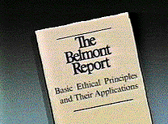
The report was created on April 18, 1979 and gets its name from the Belmont Conference Center where the document was drafted.
Report was created by the former United States Department of Health, Education, and Welfare (Health and Human Services).
The Belmont Report attempts to summarize the basic ethical principles identified by the Commission in the course of its deliberations.

Slide 31
Ethical Principles & Guidelines for Research Involving Human Subjects
(1) Respect for persons:
  Individuals should be treated as autonomous agents.
  Individuals with diminished autonomy are entitled to protection.
(2) Beneficence:
  Do not harm.
  Maximum possible benefits, and minimize potential harms.
(3) Justice:
  Fair distribution of burdens and benefits of research.

Slide 32

Applications of General Principles
Consideration of the three general principles in the conduct of clinical research leads to the consideration of:
Informed Consent Process
Assessment of Risks and Benefits
Selection of Research Participants

Slide 33
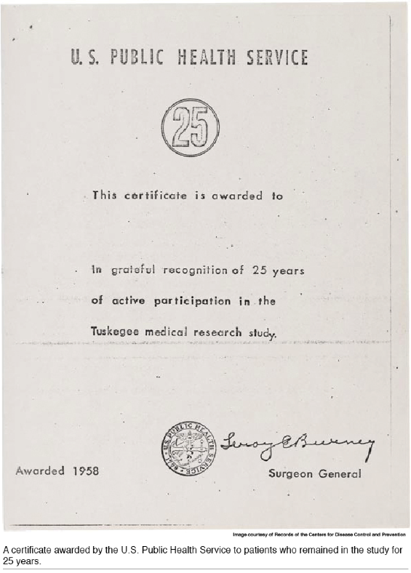

Slide 34
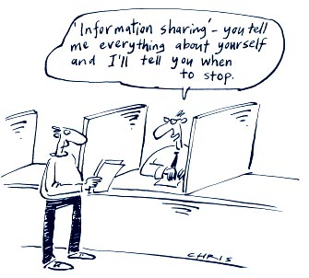
INFORMED CONSENT PROCESS
(1) Information- The consent form should provide all the information necessary for the individual
to make a reasoned decision.
(2) Comprehension-The consent form
should be crafted in a language understandable to the potential participant.
(3) Voluntariness-
The consent form should clearly indicate the participation in the research is voluntary.

Slide 35
ASSESSMENT OF RISKS AND BENEFITS
Risk refers to the probability of harm.
- Consider physical, psychological, social, and economic harms.
- Risks should be justified and minimized.
Improved search design.
Benefit refers to something that promotes health, well-being, or welfare.
-Beneficial to the participant and the society.

Slide 36
Selection of Subjects
Justice is relevant to the selection of subjects of research.
Potential subject pool appropriate for the research.
Consider whether appropriate to involve vulnerable populations.
Fair and impartial recruitment procedures.
Appropriate inclusion and exclusion criteria.
Confidentiality of the research subject.

Slide 37
Importance of Belmont report in clinical Research and in prospective with Indian (ICMR) Guidelines
The Nuremberg Code,1947,
Helsinki Declaration,1964.(revised 1975),
1971 Guidelines (codified into Federal Regulations in 1974)
On basis of these ethical guidelines and regulations evolved over years, the Indian Council of Medical Research (ICMR) also came out with ethical guidelines for Biomedical Research.
Belmont Report also derives from these Guidelines.

Slide 38

Thank you
Mr. Gaurav Doshi
International Clinical Pharmacist Recognized

